Slide 1
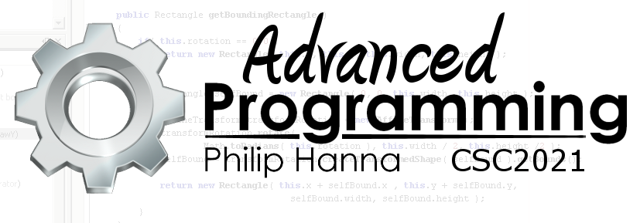
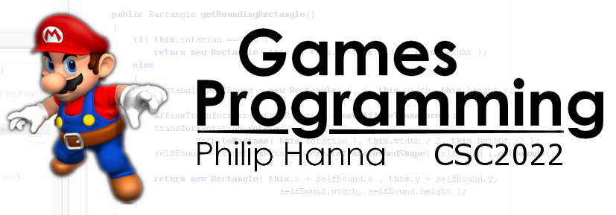
Steering Algorithms
Basic forms of steering AI movement

Slide 2
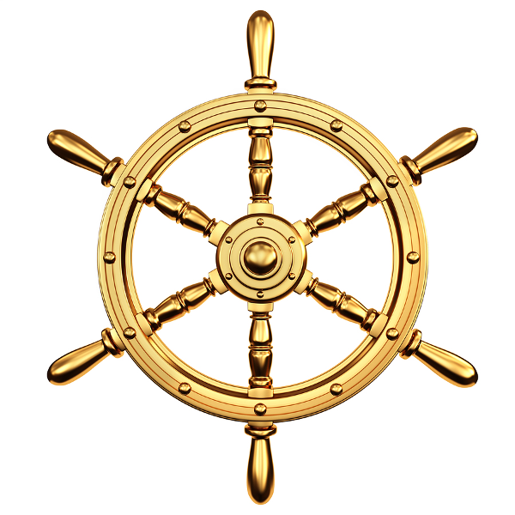
Steering Movement Algorithms

Slide 3
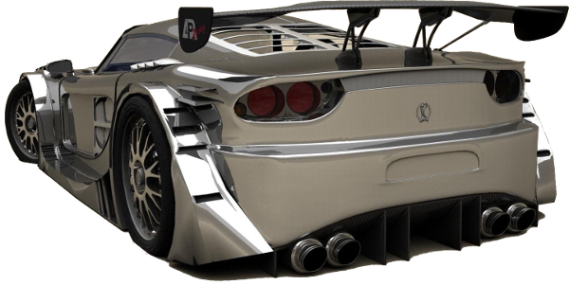
Steering behaviours extend the kinematic movement algorithms by determining acceleration (both forward movement and rotation)
In many game types (e.g. driving games) steering algorithms are typically used.
We will consider the following forms of steering behaviour:
Seek()
Flee()
Arrive()
Wander()
Pursue()
Evade()
Interpose()
Align()
Face()
Separate()
PathFollow()
AvoidObstacle()

Slide 4
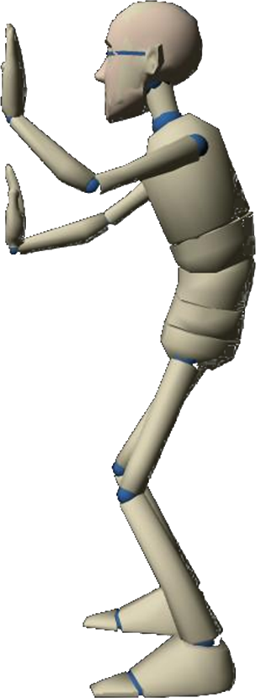
: Matching a Target Property
Basic steering algorithms work by matching a kinematic property of the target to the source, e.g. target’s position, velocity, orientation. Matching steering algorithms take source and target kinematic properties as input.
More advanced steering behaviours match a combination of properties, potentially with additional constraints.
Typically for each matching behaviour there is a readily defined opposite behaviour (e.g. Seek vs. Flee, etc.).
Flee path
Seek path

Slide 5
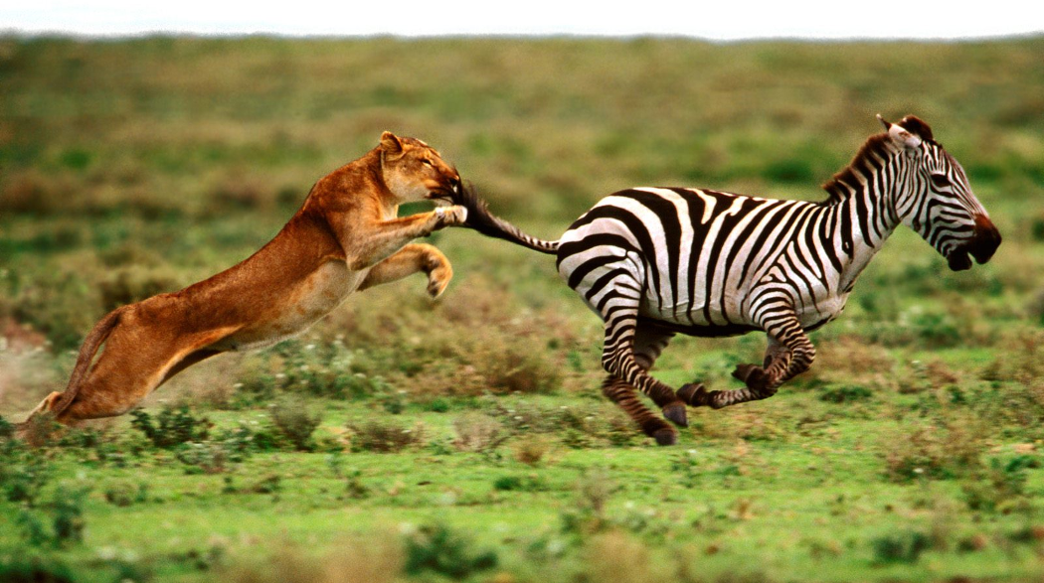
Seek and Flee

Slide 6
Seek
Seek will try to match the source position of that to a target location. The direction to the target is determined, and a corresponding maximum acceleration set towards the target.
Seek ( Vector source, Vector target, ]
float maxAcc ) {
Vector acceleration
= (target – source).normalise() * maxAcc;
return acceleration;
}
Initial velocity
Path
Target acceleration
Aside: Seek will accelerate as fast as possible towards the target. Some means of reducing velocity will be needed as the target is approached – this is offered by other forms of steering behaviour.

Slide 7
Seek
Flee
The output of Seek is used to update the position and velocity as follows:
Flee is simply the opposite of Seek, with a maximum acceleration away from the target output.
timeDelta amount of time since last update
UpdatePosition() {
velocity += acceleration * timeDelta;
rotation += angular_acc * timeDelta;
if( velocity.length() > maxSpeed )
velocity = velocity.normalise()*maxSpeed;
position += velocity * timeDelta;
orientation += rotation * timeDelta;
}
Flee
Seek
Aside: Seek does not change the orientation. Other behaviours can align orientation with movement direction.

Slide 8
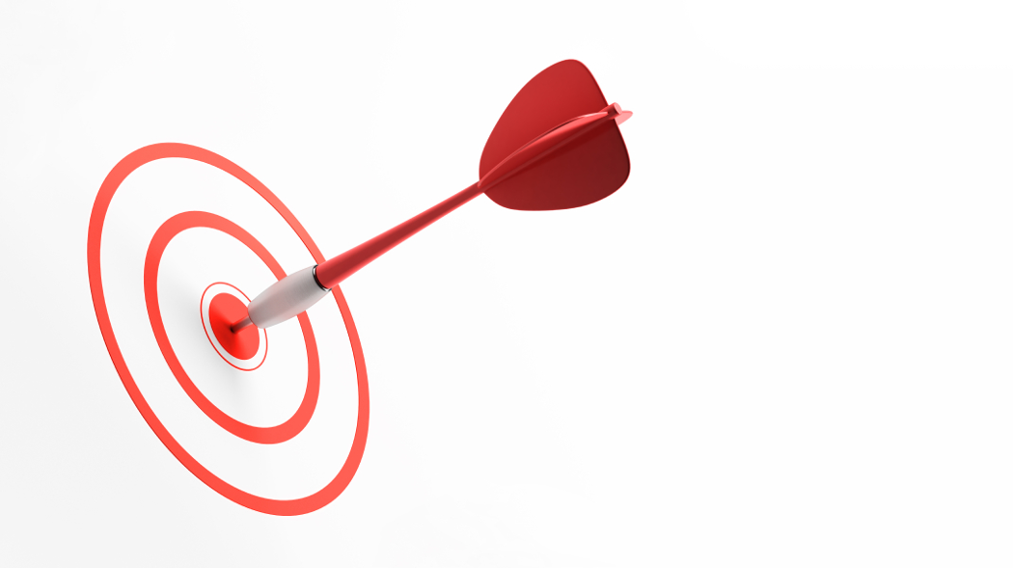
Arrive

Slide 9
Arrive
Arrive will control acceleration so that the velocity is zero once the target has been reached.
Two radii are used: an arrival radius when the target can be considered as reached, and a larger slow radius used to control when the velocity should be reduced from the maximum.
Seek
Arrive
Aside: The opposite to Arrive is Leave – although there is little need to have a behaviour that will slowly accelerate away from the target, i.e. Flee is more useful.

Slide 10
float targetSpeed;
if( distance > slowRadius )
targetSpeed = maxSpeed;
else
targetSpeed = maxSpeed *
distance / slowRadius;
Vector targetVelocity =
direction.normalise() * targetSpeed;
Arrive
If outside slow radius, then max speed, else scale speed based on distance
Arrive(Vector source, Vector target,
Vector currentVelocity,
float maxAcceleration, float maxSpeed,
float arriveRadius, float slowRadius ) {
float slowingFactor = 0.2;
Vector acceleration = [0,0,.];
Vector direction = target – source;
float distance = direction.length();
if( distance < arriveRadius )
return acceleration;
{ Determine target velocity }
{ Determine acceleration }
return acceleration }
slowingFactor = deaccelerate strength
acceleration = targetVelocity – currentVelocity;
acceleration /= slowingFactor;
if( acceleration.length() > maxAcceleration )
acceleration = acceleration.normalise()
* maxAcceleration;
return 0 if at target
Calc acceleration so that it will slow down object near target

Slide 11
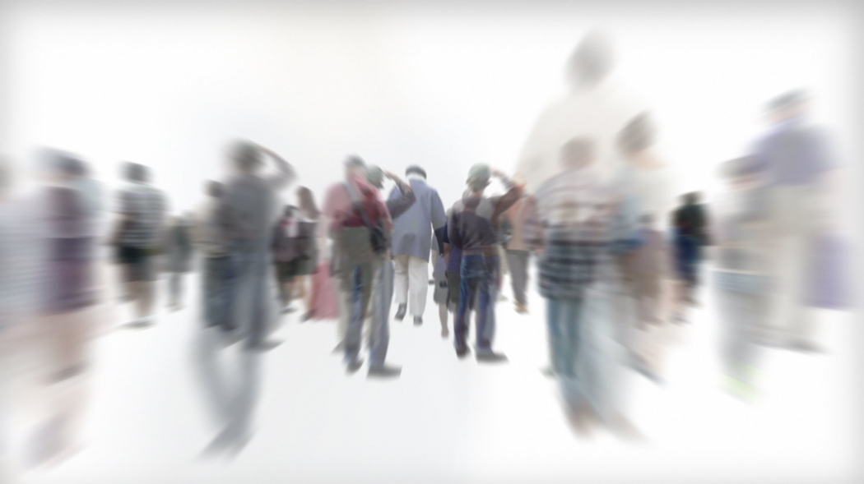
Wander

Slide 12
Wander
Wander target
Wander produces movement that gives the impression of a random walk.
To avoid jittery behaviour a circle is projected in front of the object with the object steering towards a target that is constrained to move along the perimeter.
Each update, the target is displaced by a small random amount (moving back and forth around the perimeter over time).
By controlling size of circle, distance from object and random displacement, a wide range of motion can be generated.
Circle at a defined fixed distance from object
Wander output

Slide 13
Wander
wanderRate
wanderRadius
Wander( Vector source,
float sourceOrientation, float maxAcceleration,
float wanderOffset, float wanderRadius,
float wanderRate, float wanderOrientation ) {
wanderOrientation += wanderRate
* randomBinomial();
targetOrientation =
wanderOrientation + sourceOrientation;
Vector target = source +
wanderOffset * asVector(sourceOrientation);
target += wanderRadius * asVector(targetOrientation)
{Return acceleration based on a Seek
towards the determine target location }
wanderOrientation
Work out new target orientation
wanderOffset
Any random function will suffice, binomial is smooth
source
Work out new target position
Return a (2D) vector with the same orientation as the specified angle
Vector2 asVector( float angle ) {
return new Vector2(
(float)Math.Cos(angle),
(float)Math.Sin(angle) ); }

Slide 14
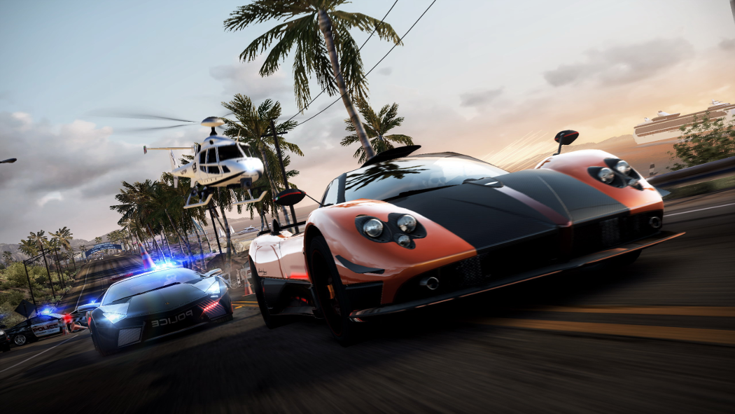
Pursuit
Evade

Slide 15
Pursuit
Seek will head directly towards the target.
If the target is moving, it is better to aim towards where the target is likely to be in the future – a behaviour known as Pursuit.
Different algorithms can be used to predict the likely future position. A simple, yet effective, approach is to assume the target will continue to move with the same current velocity.
The target’s movement can then be used to calculate it’s future position, which is used as the seek position.
Seek route
Pursue route
Target velocity

Slide 16
Pursuit
Evade
Pursuit( Vector source, Vector target,
Vector sourceVel, Vector targetVel ) {
float maxPrediction;
Vector direction = target – source;
float distance = direction.length();
float speed = sourceVel.length();
if( speed <= distance / maxPrediction )
prediction = maxPrediction;
else prediction = distance / speed;
target += targetVel * prediction;
return Seek( source, target)
}
Evade is simply the opposite of Pursuit, i.e. the evaders flees from the projected future direction
Maximum time to predict
Predicted future position
Calculated Seek target
If time to target is too long, then use maximum prediction time, else determine time to contact
Target velocity
Determine new target and Seek acceleration towards it
Time to contact
= distance / speed

Slide 17
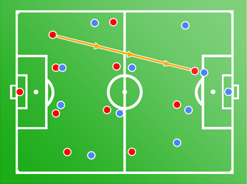
Interpose
Interpose steers towards the mid point of two defined targets (e.g. for intercepting a pass, blocking a shot, etc.).
It is similar to Pursuit except that a mid-point between the targets is calculated, and the time to this point used to determine the future locations of the targets.
The predicted future locations are then used to find the target mid-point for the Seek behaviour.
Current mid-point
Predicted mid-point
Predicted future position

Slide 18
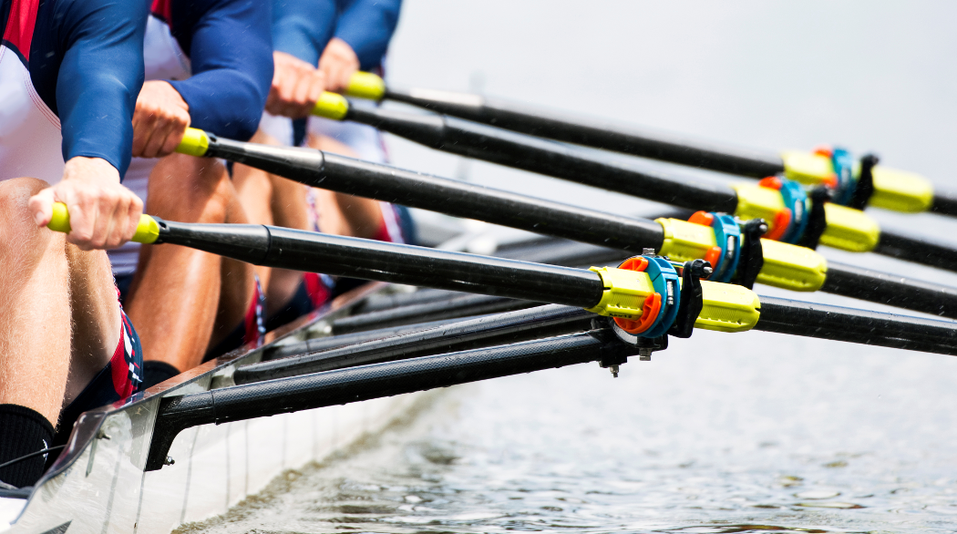
Align

Slide 19
Align
Align tries to match the orientation of the source with that of the target (i.e. there is no linear movement, only rotation).
Align is very similar to Arrive with one added aspect: orientations wrap around every 2π radians, entailing some range mapping.
Align uses two ranged triggers: one for reducing the angular velocity, and another when the alignment is close enough.
Map the input angle into the [-π, π] range
float standardiseAngle( float input )
{
float output = input % (2π);
if( Math.abs(output) > π)
output += Math.signum(output) * 2π;
}

Slide 20
Align
float targetRotation = 0.0;
if( rotationSize > slowAngle )
targetRotation = maxRotation;
else
targetRotation = maxRotation
* rotationSize / slowRadius
targetRotation *= signum( rotation );
Align(float source, float target,
float maxAngularAcc, float maxRotation,
float arriveAngle, float slowAngle ) {
float slowingFactor = 0.2;
float angularAcceleration = 0.0;
float rotation =
standardiseAngle( target – source);
float rotationSize = abs(rotation);
if( rotationSize < arriveAngle )
return angularAcceleration ;
{ Determine target rotation }
{ Determine angular acceleration }
return angularAcceleration }
If outside slow distance then max rotation, else slow rotation
source orientation and target orientation
Reintroduce rotation direction (left/right)
angularAcceleration =
targetRotation – source;
angularAcceleration /= slowingFactor
If( abs(angularAcceleration ) > maxAngularAcc )
angularAcceleration /=
angularAcceleration * maxAngularAcc;
Determine difference in orientation

Slide 21

Face
Face steers the source to look at the target.
To do this, a target orientation towards the target is calculated and then Align used to provide the steering acceleration.
Face( Vector source, Vector target ) {
Vector direction = target – source;
if( direction.length() > 0 )
Align( ...direction ... );

Slide 22
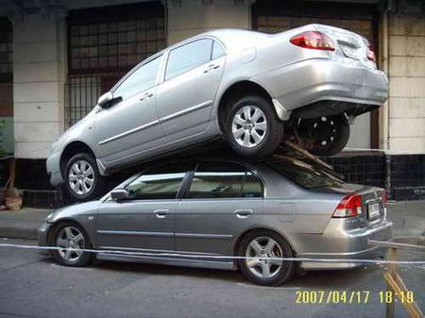
LookWhereYouAreGoing
This form of steering can be used to orientate the character to the direction of movement.
The process is nearly identical to Face, except that the target direction is based on the current velocity.
LookWhereYouAreGoing( Vector velocity ) {
if( velocity.length() > 0 ) {
float direction =
atan2(-velocity.x, velocity.z);
Align( ... direction ... );
}

Slide 23

Separate

Slide 24
Separate
Separate( Vector source, Array targets,
float separateThreshold, float separateDecay, float maxAcceleration ) {
Vector acceleration = [0,...];
foreach( Object target in targets ) {
Vector direction = target.position - source;
float distance = direction.length();
if( distance < separateThreshold ) {
float separateStrength =
min( separateDecay * distance * distance, maxAcceleration );
acceleration += direction.normalise() * separateStrength;
}
if( acceleration.length() > maxAcceleration )
acceleration = acceleration.normalise() * maxAcceleration;
return acceleration;
Separate stop objects from becoming crowded. Objects move away from others that get too close.
targets holds object to avoid
Individual repulsion
separateThreshold controls separation distance drop-off
Individual repulsion
Net acceleration
Update net acceleration

Slide 25

Key takeaways:
Lots of different types of steering behaviour can be defined.
Steering behaviours are designed to be combined together to product the desired form of movement.

